Slide 1
ActiveData
activedata.allizom.org

Slide 2
ActiveData
Fast filtering
Fast aggregates
API is a query language
Simple service
curl http://activedata.allizom.org/query -X POST -d "{\"from\":\"unittest\"}"

Slide 3
ActiveData
Fast filtering
Fast aggregates
API is a query language
Simple service
curl http://activedata.allizom.org/query -X POST -d "{\"from\":\"unittest\"}"
Wrangle large volume of data with small effort

Slide 4
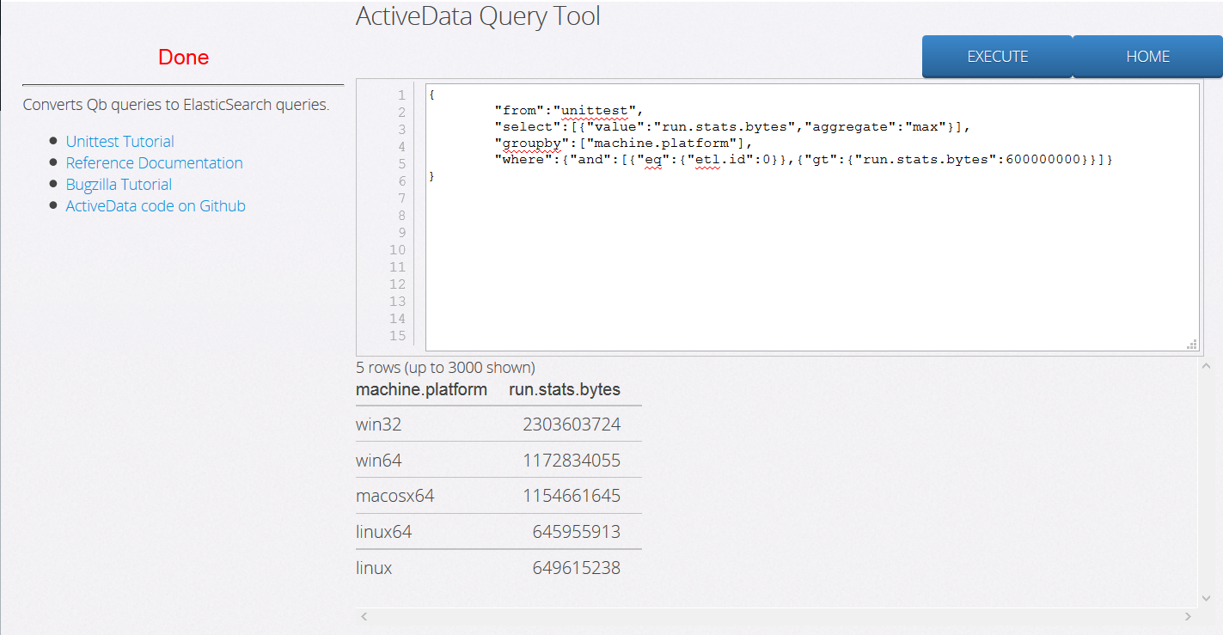
Query Tool
http://activedata.allizom.org/tools/query.html

Slide 5
Query Tool
Helpful links
http://activedata.allizom.org/tools/query.html

Slide 6
Query Tool
Write your query
http://activedata.allizom.org/tools/query.html

Slide 7
Query Tool
Send query to ActiveData service
http://activedata.allizom.org/tools/query.html

Slide 8
Query Tool
View results
http://activedata.allizom.org/tools/query.html

Slide 9
Query
Similar to SQL
Qb Query
SQL
{
"select":{
"name": "count",
"value":"run.stats.bytes",
"aggregate":"max“
},
"from":
"unittest",
"groupby":[
"machine.platform“
],
"where":{
"and":[
{"eq":{"etl.id":0}},
{"gt":{"run.stats.bytes":6000}}
]
}
}
SELECT
"machine.platform",
MAX("run.stats.bytes") AS "count",
FROM
UNITTEST
GROUP BY
"machine.platform"
WHERE
"etl.id" = 0 AND
"run.stats.bytes" > 6000
http://activedata.allizom.org/tools/query.html

Slide 10
Response
Extra metadata in response
{"meta": {
"active_data_response_time": 1.0833179999999998,
"es_response_time": 1.0570859999999997,
"content_type": "application/json",
"format": "cube“,
"es_query": {
"sort": [],
"query": {
"filtered": {
"filter": {"match_all": {}}, "query": {"match_all": {}}
}
},
"facets": {},
"from": 0,
"size": 10
}
}, "data": ...}

Slide 11
Backend
Code at https://github.com/klahnakoski/TestLog-ETL/tree/etl

Slide 12
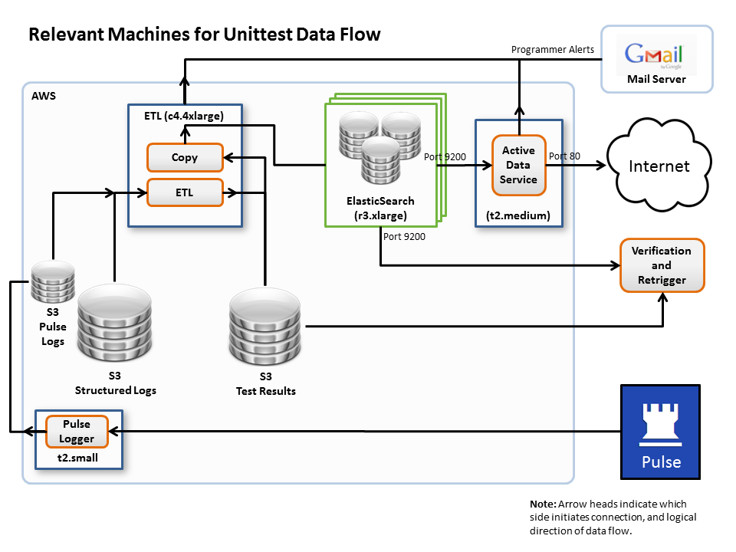
Architecture

Slide 13
Architecture
Pulse Logger
Exchange = “exchange/build/normalized“
Topic = “#”
Collect 100, then push to S3

Slide 14
Architecture
ETL (single machine)
15 processes, 4 Python threads each
100meg/hour IN, 40meg/hour OUT
Manually start more, if required

Slide 15
Architecture
Elasticsearch Document Store
Three nodes
Fast indexing and fast aggregates
Billion test results

Slide 16
Architecture
ActiveData Service
Provides a query API (and translation)
Protect raw ElasticSearch cluster

Slide 17
Elasticsearch vs Redshift
ElasticSearch
  Lower cost, use spot instances for even lower price
  4x faster aggregates? (still investigating)
Redshift
  Easier to deploy
  Better query language (PSQL)
  Good monitoring tools
Summary at https://wiki.mozilla.org/Auto-tools/Projects/ActiveData/Redshift

Slide 18
Current Problems
Lack of tools to explore data
No way to see the metadata
Lack of examples to write queries
Elasticsearch is starting to show instability with only 3 nodes
Lots of bugs in ActiveData service
Bad ETL from past still polluting datastore (and S3)

Slide 19
Future Work
Real customers to drive improvements
Increase test cases to cover more queries (currently 63 tests)
Add Metadata exploration to Query Tool
Code to leverage spot instances
More ElasticSearch tuning
Reduce Costs…

Slide 20
Potential Cost Reduction
Elasticsearch replicas on spot instances
  More nodes for better query performance
  Accept slow service when spot too expensive
  Single node has no backup, but S3 can
ETL using spot instances only
  Currently no need to load ES immediately
  We can wait hours for a better price
  Scale if we need to reprocess, or load database

Slide 21
END

Slide 22
Motivation
Not Presented

Slide 23

Motivation
Many Clients
MoDevMetrics
dzAlerts
charts.m.o
Elasticsearch

Slide 24
Motivation
Problem: Too Many Translators
MoDevMetrics
Translator
dzAlerts
charts.m.o
Translator
Translator
Elasticsearch

Slide 25
Motivation
Solution: Single Translator
MoDevMetrics
dzAlerts
charts.m.o
Query Service
Translator
Elasticsearch

Slide 26
Motivation
Benefit: Multiple Backends
MoDevMetrics
dzAlerts
charts.m.o
Query Service
Translator
Translator
Translator
Translator
Elasticsearch
Redshift

Slide 27
Motivation
Benefit: Diverse Clients
Python
Javascript
Others
Query Service
Elasticsearch
Redshift

Slide 28
ActiveData API
Start with MVP
Query Tool
ActiveData
Elasticsearch
(unittests)

